Slide 1
COMPUTER ORGANIZATION AND ARCHITECTURE
Prof. (Dr.) Rijwan Khan
Department of Computer Science and Engineering
School of Computing
Galgotias University, G. B. Nagar

Slide 2

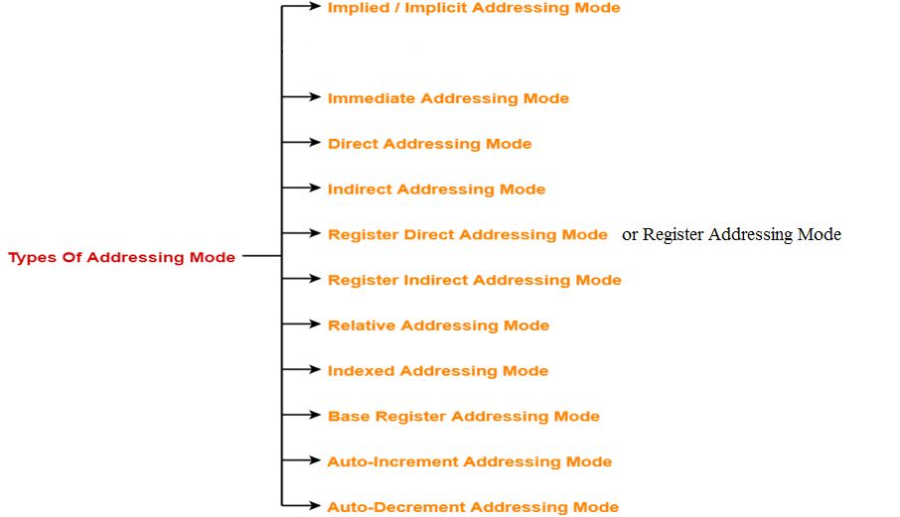
ADDRESSING MODES

Slide 3
AB+
Implied mode:: In implied addressing the operand is specified in the instruction itself. In this mode the data is 8 bits or 16 bits long and data is the part of instruction. Zero address instruction are designed with implied addressing mode
Immediate addressing mode (symbol #):In this mode data is present in address field of instruction. Designed like one address instruction format.
Note: Limitation in the immediate mode is that the range of constants are restricted by size of address field.
Register mode: In register addressing the operand is placed in one of 8 bit or 16 bit general purpose registers. The data is in the register that is specified by the instruction.
Here one register reference is required to access the data.
Register Indirect mode: In this addressing the operand’s offset is placed in any one of the registers BX,BP,SI,DI as specified in the instruction. The effective address of the data is in the base register or an index register that is specified by the instruction.
Here two register reference is required to access the data.
.

Slide 4
Auto Indexed (increment mode): Effective address of the operand is the contents of a register specified in the instruction. After accessing the operand, the contents of this register are automatically incremented to point to the next consecutive memory location.(R1)+. Here one register reference, one memory reference and one ALU operation is required to access the data.
Example
Add R1, (R2)+ // OR
R1 = R1 +M[R2]
R2 = R2 + d
Auto indexed ( decrement mode): Effective address of the operand is the contents of a register specified in the instruction. Before accessing the operand, the contents of this register are automatically decremented to point to the previous consecutive memory location. –(R1) Here one register reference, one memory reference and one ALU operation is required to access the data.
Example:
Add R1,-(R2) //OR
R2 = R2-d
R1 = R1 + M[R2]

Slide 5
Direct addressing/ Absolute addressing Mode (symbol [ ]): The operand’s offset is given in the instruction as an 8 bit or 16 bit displacement element. In this addressing mode the 16 bit effective address of the data is the part of the instruction. Here only one memory reference operation is required to access the data.
Indirect addressing Mode (symbol @ or () ):In this mode address field of instruction contains the address of effective address. Here two references are required. 1st reference to get effective address. 2nd reference to access the data. Based on the availability of Effective address, Indirect mode is of two kind:
Register Indirect: In this mode effective address is in the register, and corresponding register name will be maintained in the address field of an instruction. Here one register reference, one memory reference is required to access the data.
Memory Indirect: In this mode effective address is in the memory, and corresponding memory address will be maintained in the address field of an instruction. Here two memory reference is required to access the data.
Indexed addressing mode: The operand’s offset is the sum of the content of an index register SI or DI and an 8 bit or 16 bit displacement.
Based Indexed Addressing: The operand’s offset is sum of the content of a base register BX or BP and an index register SI or DI.

Slide 6
Based on Transfer of control, addressing modes are:
PC relative addressing mode: PC relative addressing mode is used to implement intra segment transfer of control, In this mode effective address is obtained by adding displacement to PC.
Base register addressing mode: Base register addressing mode is used to implement inter segment transfer of control. In this mode effective address is obtained by adding base register value to address field value.

Slide 7
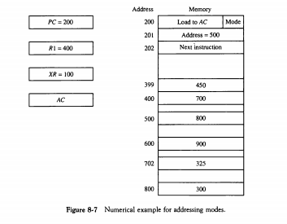
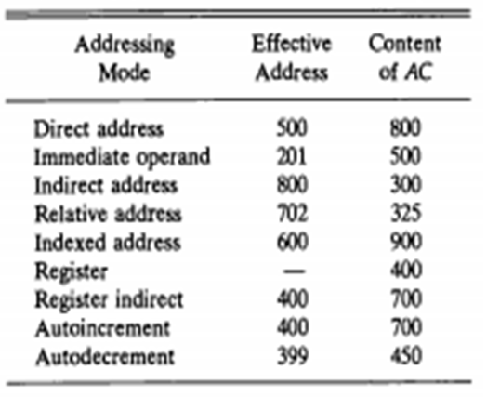

Slide 8


